Slide 1
super-Market management system

Slide 2
Team members :-
rabea adel
ahmed mansour

Slide 3
I/O Types & Process
All of our inputs will be brought from user as ( Integers & Strings )
The output will be console printed from the binary files
Process :
The user will be asked to enter the password to proceed with the program.
The user will then get into one of the four following entries
1- Suppliers 2- Products
3- Department 3- Employees
The user has the ability of adding, deleting, updating the data in the data base Binary-Files.

Slide 4
Some Advantages
1- Security in storage via data Encryption
2-APPly relationships between tables like(one –to-many and many-to-many)
3-Identity id for all tables
4- Apply a lot of functions like insert and update and delete and search
5-our project take less time because we interested with COMPLEXITY( time and space)

Slide 5
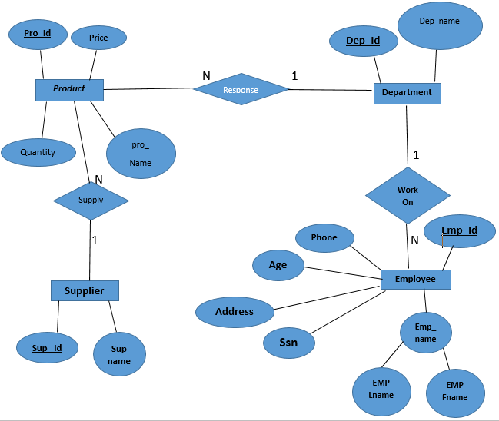
ER schema diagram

Slide 6
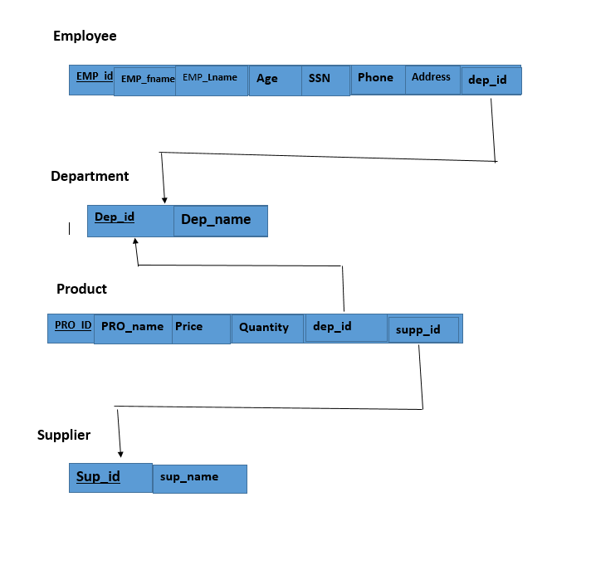
relational database schema

Slide 7
S-Market management system
Our application has 4-main entries
1- Suppliers : An entry for the file that has all the data of the market’s suppliers, name ,company name and the type of product that he offers.
operation that can be preformed on the supplier
-adding anew supplier -display all supplier
-delete supplier - search about an supplier via id
-update the information of supplier

Slide 8
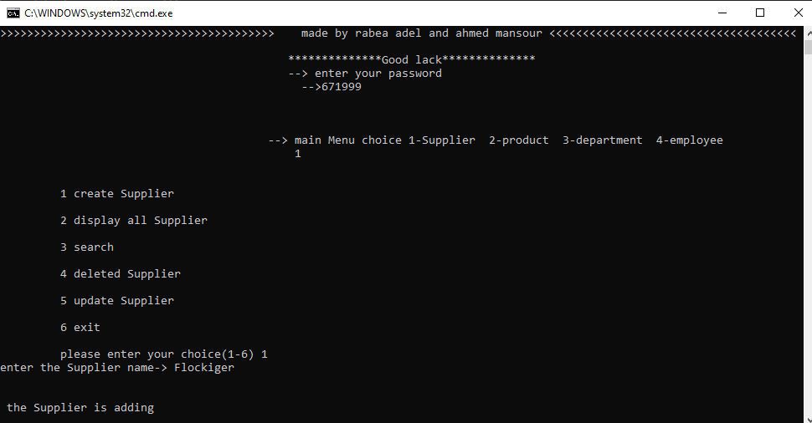
The process of adding anew supplier

Slide 9
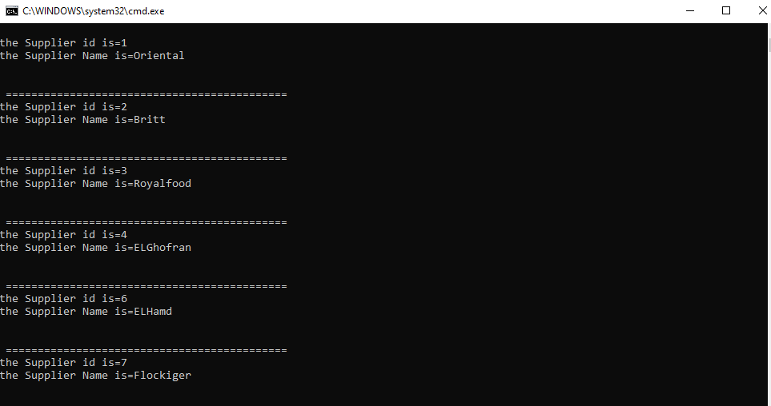
The process of display all supplier

Slide 10
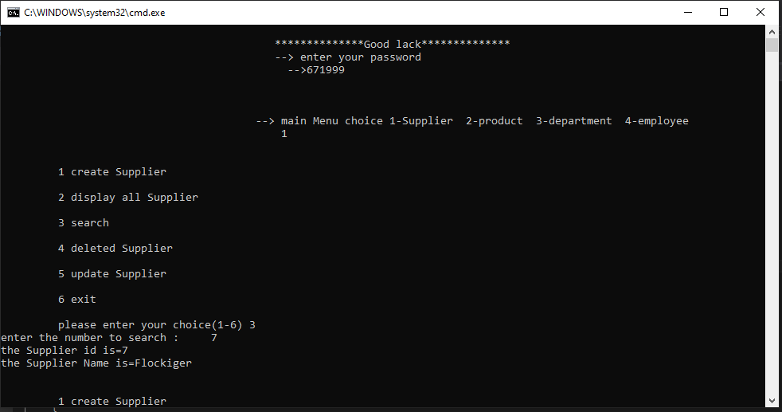
The process of search about supplier

Slide 11
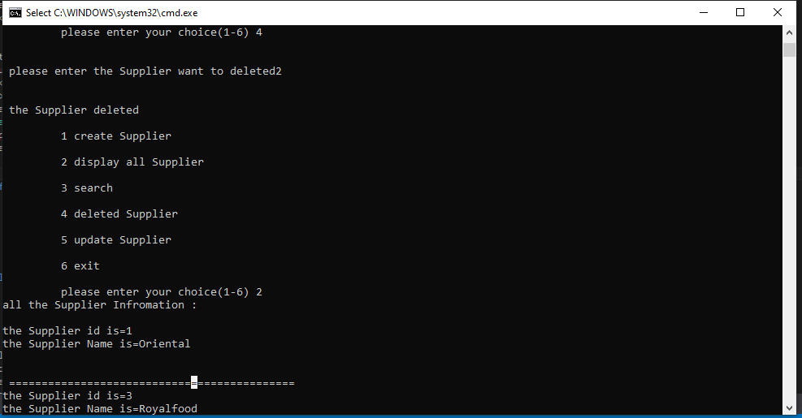
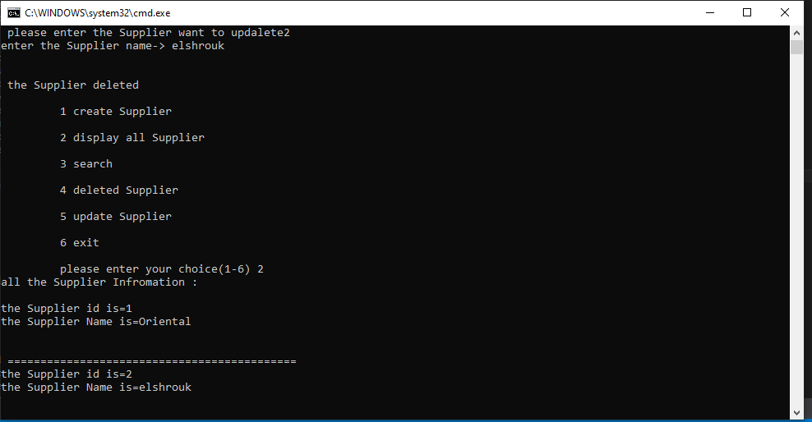
The process of update and delete any supplier

Slide 12
S-Market management system
2- Products : An entry for the file that has all the data of the market’s products, name ,price ,quantity ,department ID ,supplier ID for each product.
operation that can be preformed on the products
-adding anew products -display all products
-delete products - search about an products via id
-update the information of products

Slide 13
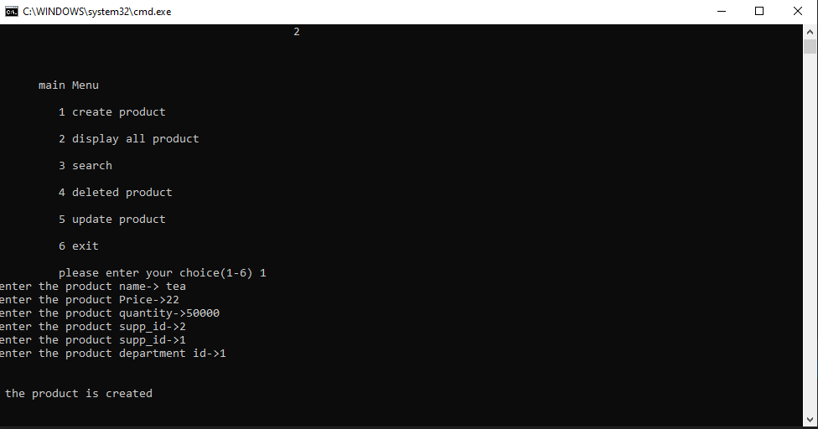
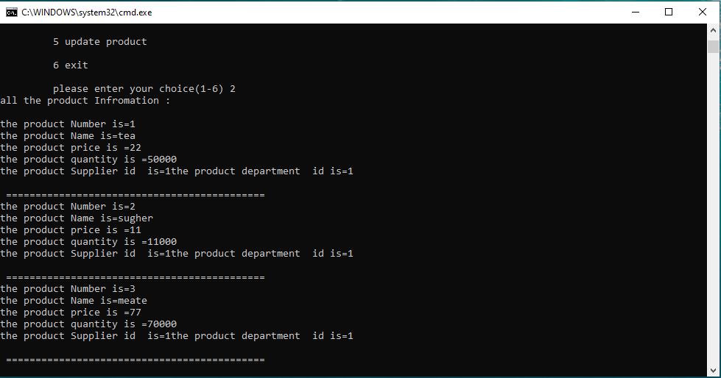
The process of adding anew and display all Products

Slide 14
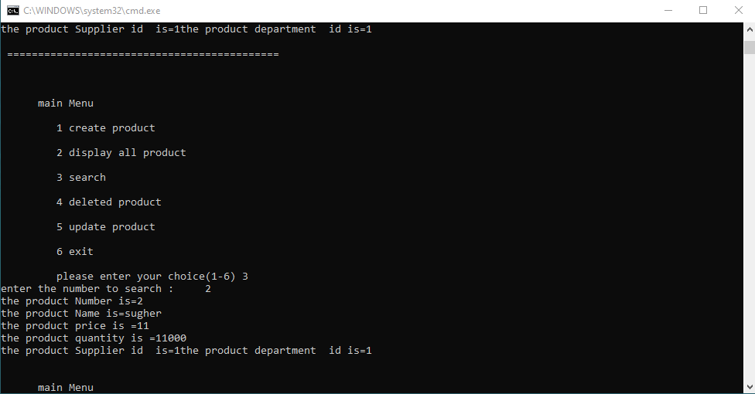
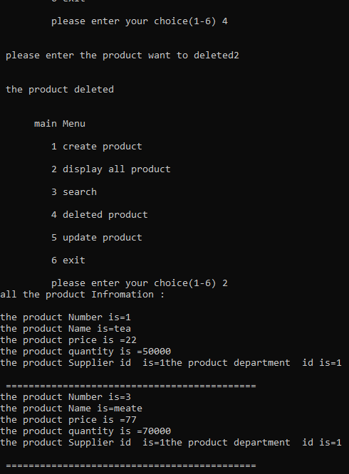
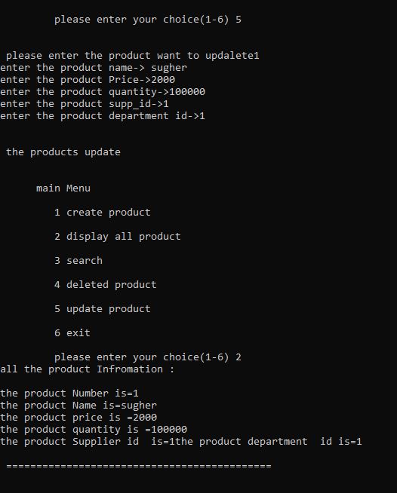
The process of search about Product and update and delete Product

Slide 15
S-Market management system
3- Department : An entry for the file that has all the data of the market-product’s Department Name, Identity ID
operation that can be preformed on the Department
-adding anew Department -display all Department
-delete Department - search about an Department via id
-update the information of Department

Slide 16
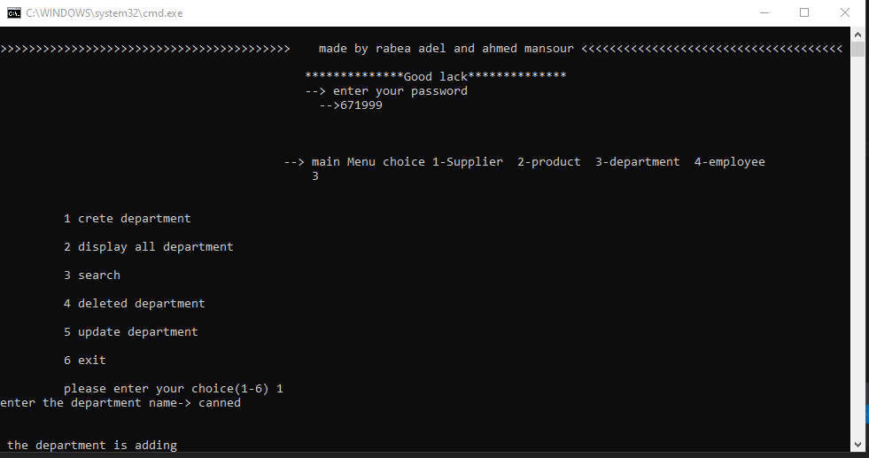
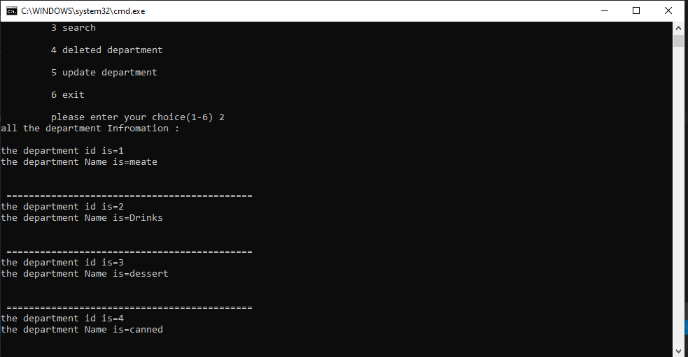
The process of adding anew and display all Department

Slide 17
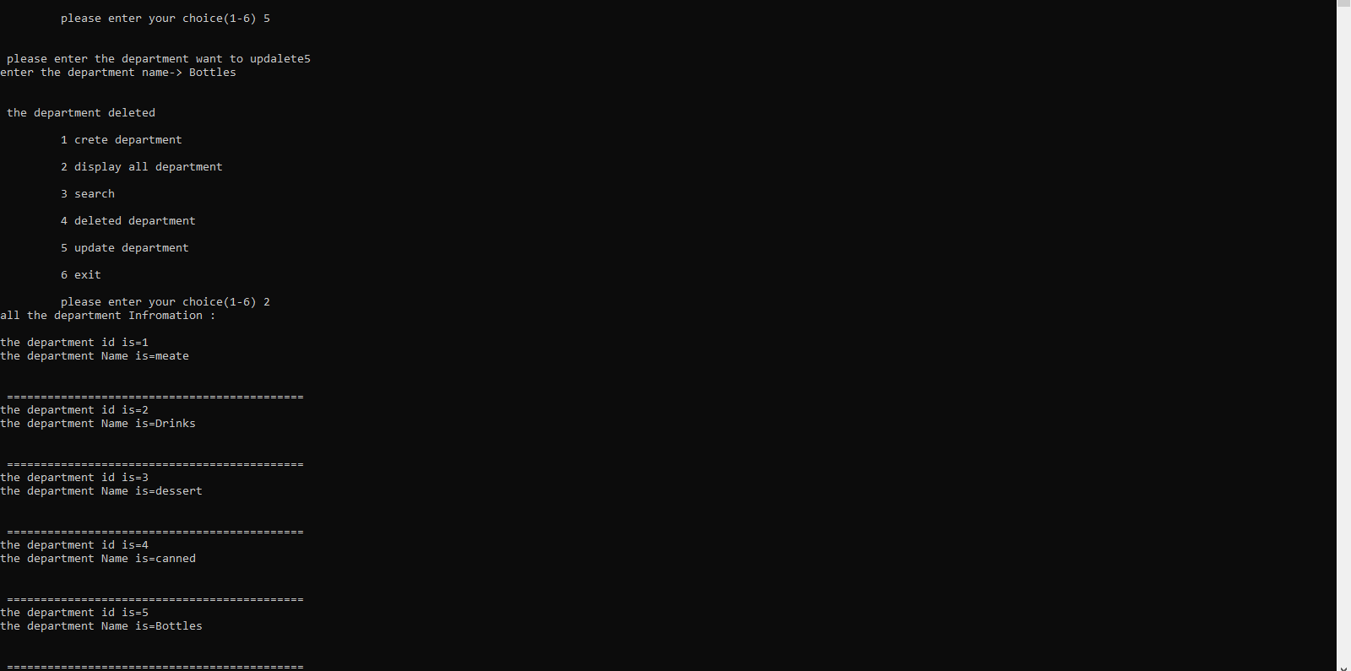
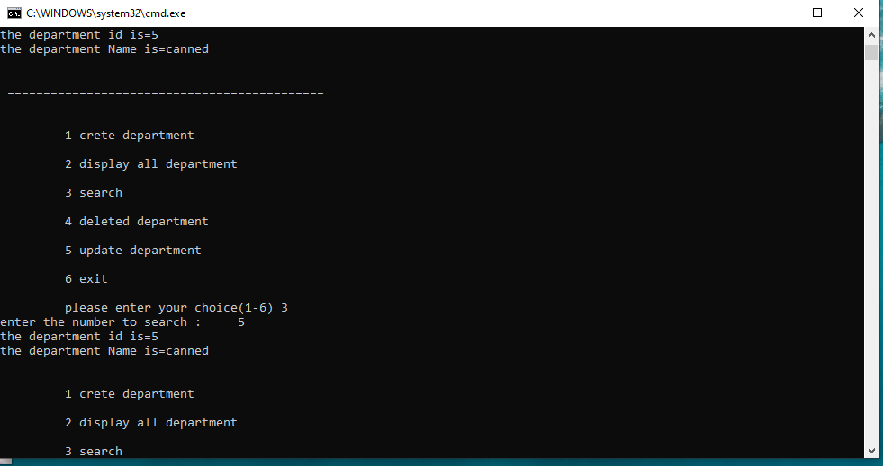
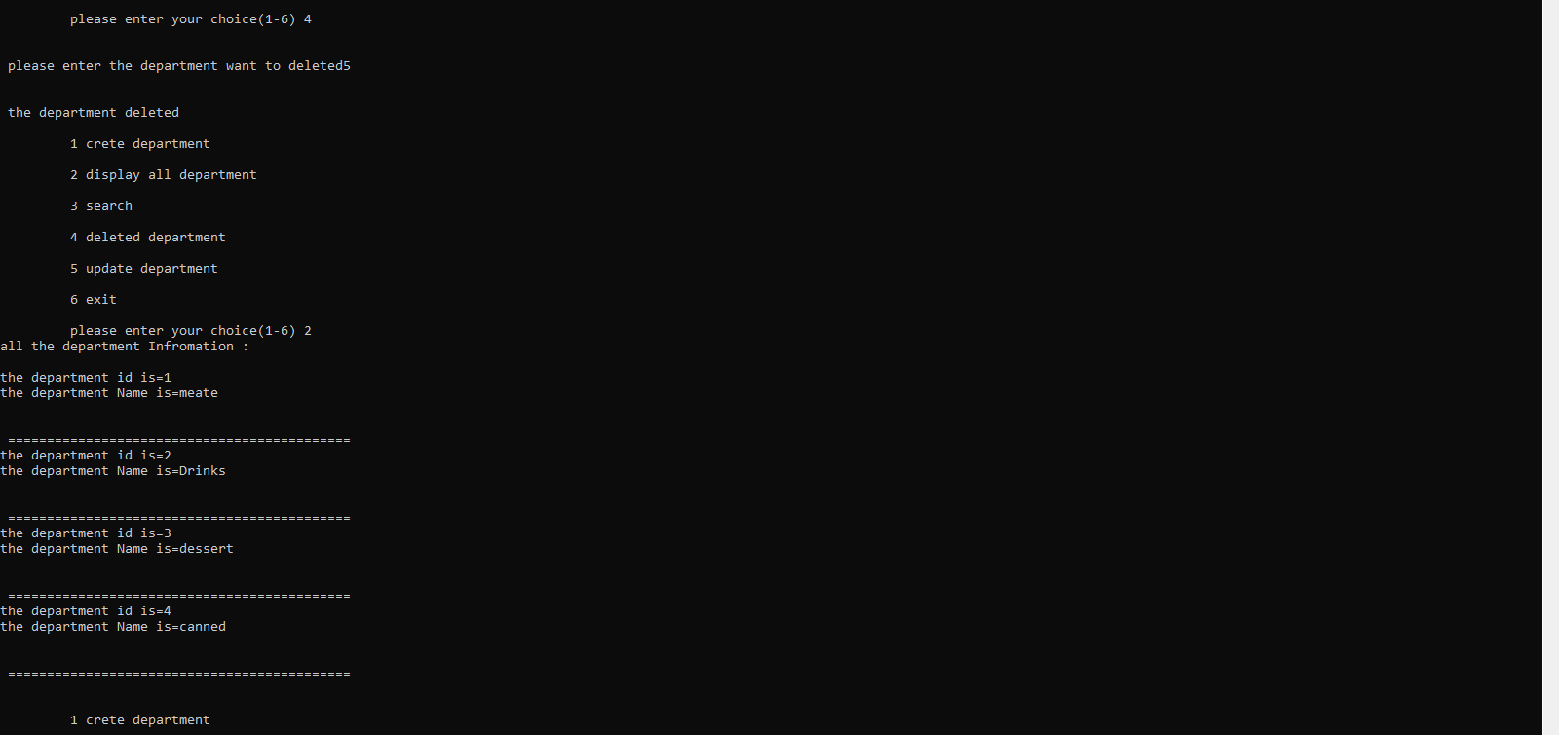
The process of search about Department and update and delete Department

Slide 18
S-Market management system
4- Employees : An entry for the file that has all the data of the market’s Employees Name( First & Last ), Age , Identity ID , Address, SSN, Department ID
operation that can be preformed on the Employees
-adding anew Employees -display all Employees
-delete Employees - search about an Employees via id
-update the information of Employees

Slide 19
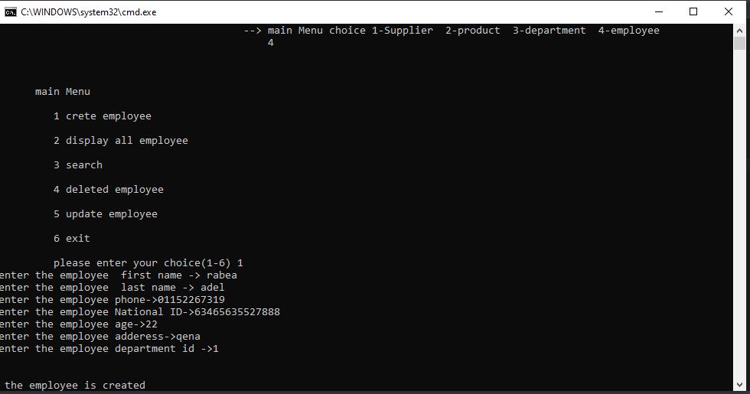
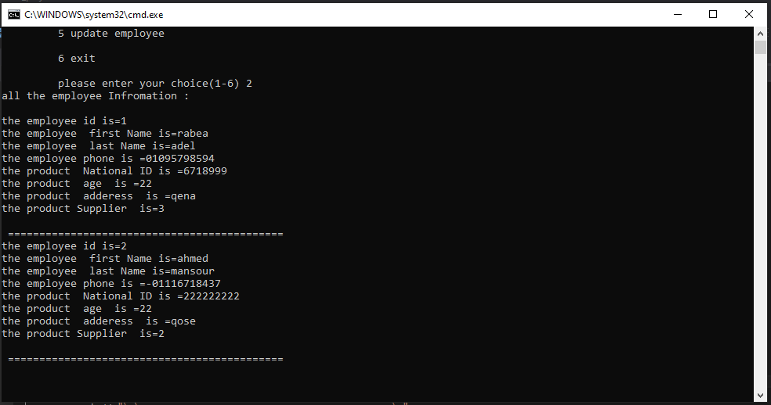
The process of adding anew and display all Employees

Slide 20
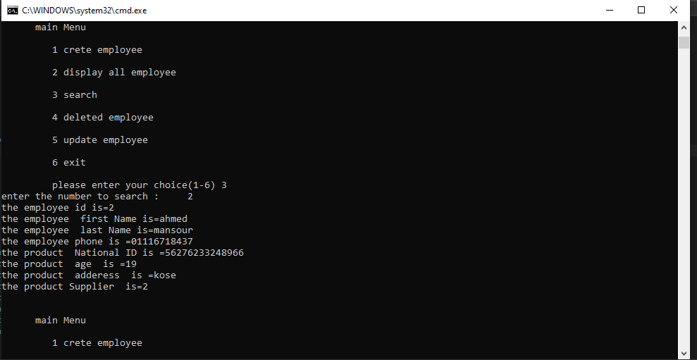
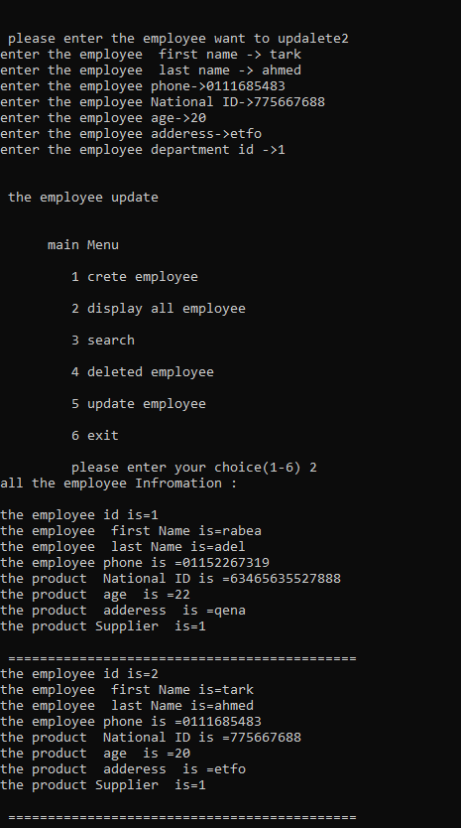
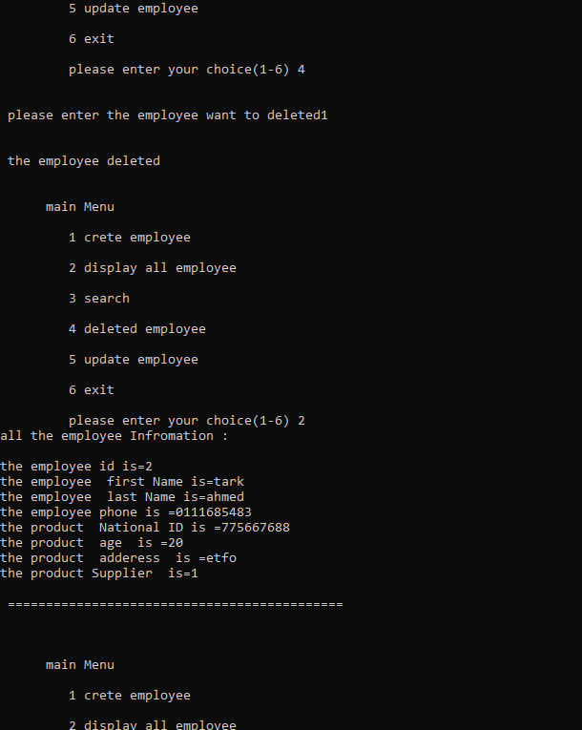
The process of search about Employees and update and delete Employees

Slide 21
PROGRAMM TEST
RUN

